Slide 1
RNN, LSTM, GRU
Artificial Intelligent and Machine Learning Class
Rizka Wakhidatus Sholikah

Slide 2
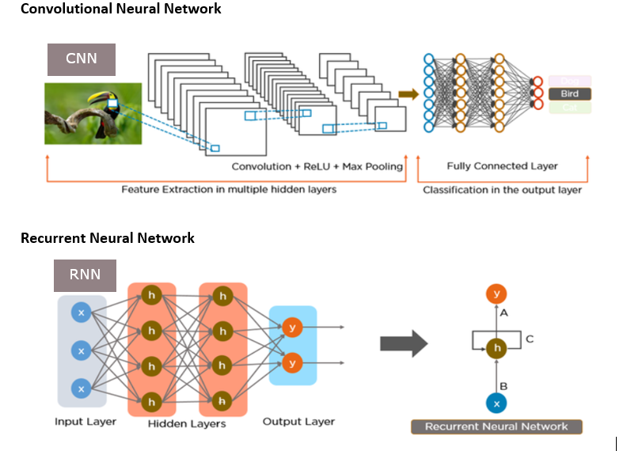
RNN

Slide 3
Review CNN
In CNN the input is one image and output the probability distribution of classes
But what if the input is sequential data??

Slide 4
Sequential Learning
Sequential learning is a process to learn from data that has sequence.
The model need to process the input in sequential manners and use the previous information to understand the next information.
Example:
I am studying AI right now
Example of Sequence data
Speech
DNA sequence
Sentences
etc

Slide 5
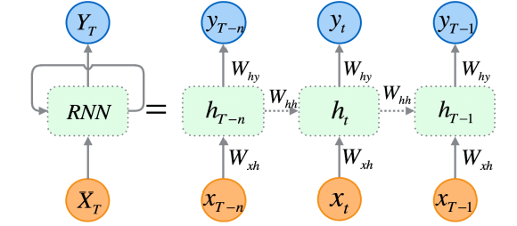
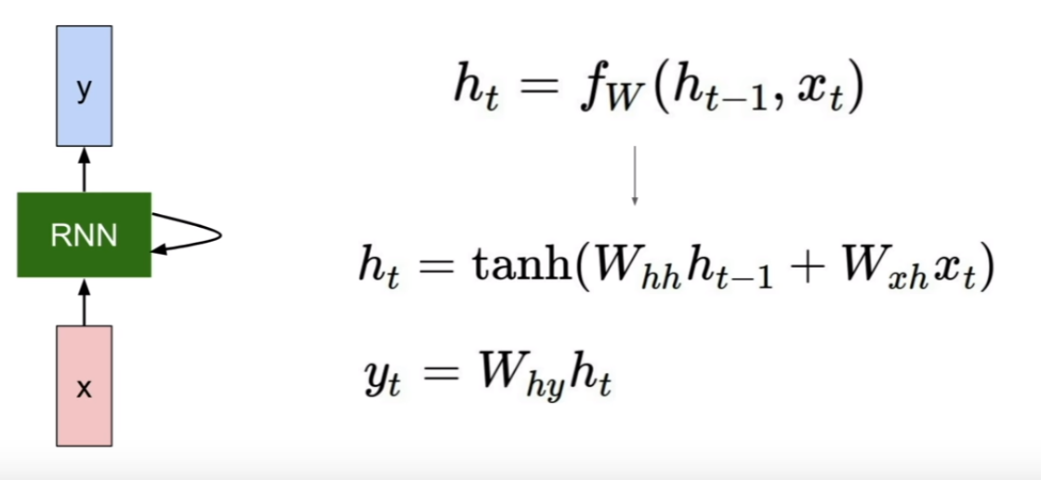
RNN
RNN = Recurrent Neural Network.
RNN is used and suitable for sequential data.
RNN remembering previous information in a sequential. Current output is affected by the previous input

Slide 6
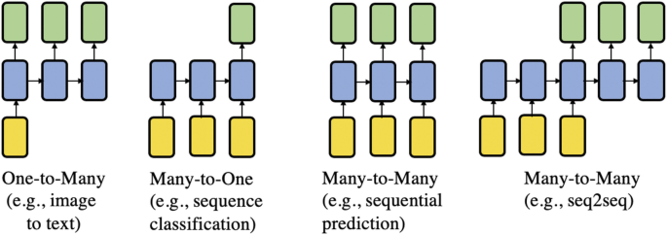
RNN
Type of RNN

Slide 7

RNN
Problem in RNN
Vanishing Gradient → Information fade over time
Only focus on new information
Long term information no longer has effect
Simple example
Multiplication with value < 1
0.5×0.5×0.5×0.5×0.5=0.03125
Exploding Gradient → The gradient became too large
The update weight became huge
Unstable model
Simple example
Multiplication with value >1
1.5×1.5×1.5×1.5×1.5=7.59

Slide 8
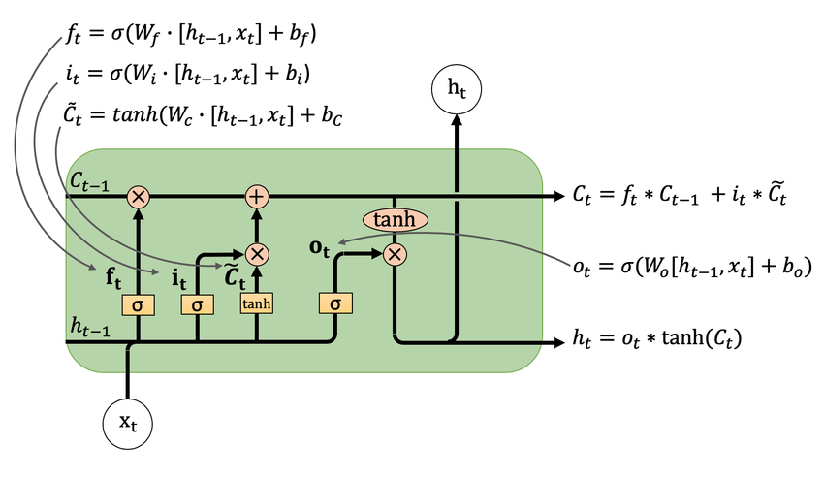
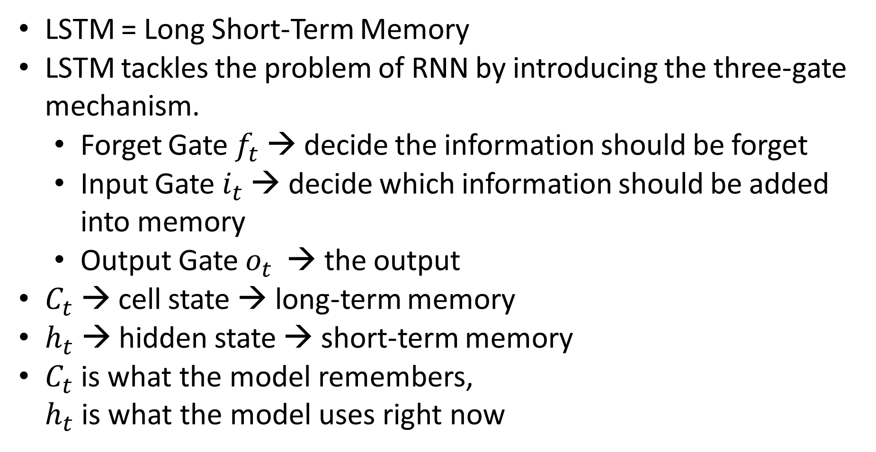
LSTM
LSTM = Long Short-Term Memory
LSTM tackles the problem of RNN by introducing the three-gate mechanism.
Forget Gate $f_{t}$ → decide the information should be forget
Input Gate $i_{t}$ → decide which information should be added into memory
Output Gate $o_{t}$ → the output
$C_{t}$ → cell state → long-term memory
$h_{t}$ → hidden state → short-term memory
$C_{t}$ is what the model remembers, $h_{t}$ is what the model uses right now
https://www.researchgate.net/publication/351291905_Long_Short-Term_Memory_Networks_for_Facility_Infrastructure_Failure_and_Remaining_Useful_Life_Prediction/figures?lo=1&utm_source=google&utm_medium=organic

Slide 9
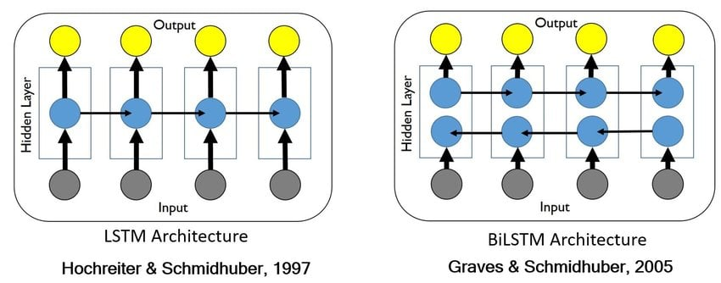
LSTM
Bidirectional LSTM (Bi-LSTM)
Type of LSTM that has two direction, forward and backward
https://www.researchgate.net/publication/324769532_A_Deep_Learning_based_Approach_to_Reduced_Order_Modeling_for_Turbulent_Flow_Control_using_LSTM_Neural_Networks/figures?lo=1&utm_source=google&utm_medium=organic

Slide 10
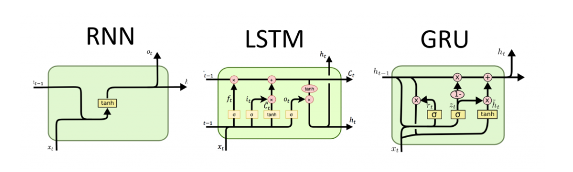
GRU
GRU = Gated Recurrent Unit
GRU tackle the computational of LSTM to make it more efficient

Slide 11
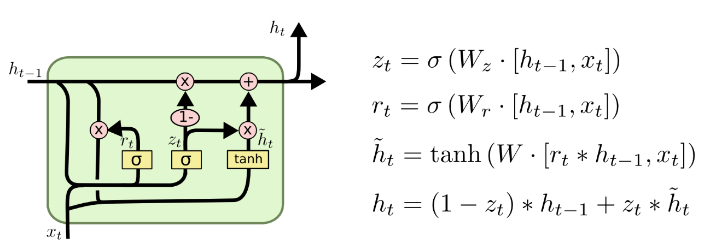
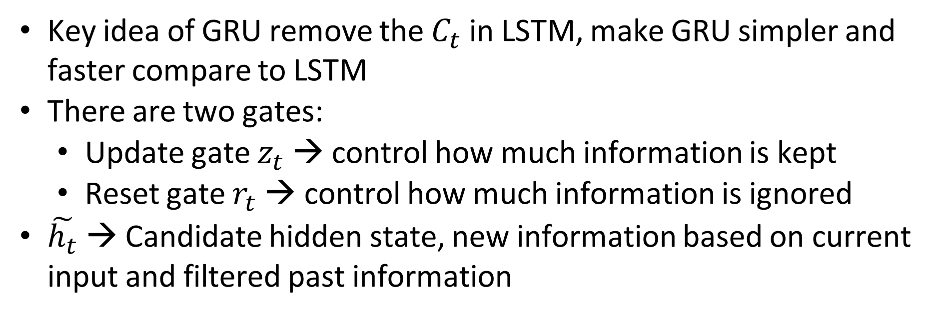
GRU
Key idea of GRU remove the $C_{t}$ in LSTM, make GRU simpler and faster compare to LSTM
There are two gates:
Update gate $z_{t}$ → control how much information is kept
Reset gate $r_{t}$ → control how much information is ignored
$\tilde{h_{t}}$ → Candidate hidden state, new information based on current input and filtered past information

